Slide 1
FINAL PROJECT- 582
DATA DASHBOARD
BY
SREENIJA DHARMA

Slide 2
DATA SOURCE: Tableau Public Sample Airbnb Listings in New York City DATA LINK : http://insideairbnb.com/get-the-data/
MEASURES: DIMENSIONS
Beds Host id
Number of records Host scince
Number of reviews Name
Price Neighbourhood
Review scores rating Property type
Reviews fixed Room type
Airbib_nyc Zipcode

Slide 3
Why I selected this dataset:
A Tableau project may benefit from using the Airbnb database since it offers a wealth of fascinating data to work with, including information on the location, cost, availability, and ratings of rooms.
This data may be studied to learn more about the habits and preferences of Airbnb hosts and guests as well as to comprehend global market trends in different cities and geographical areas.
Additionally, the dataset contains details about the different kinds of properties, amenities, and reviews, which can be used to spot patterns and trends in consumer preferences and satisfaction.
In general, the Airbnb dataset may be a great source of data for developing visualizations and dashboards that can provide insightful information for organizations and people seeking to comprehend the workings of the sharing economy and the travel sector.

Slide 4
What I want my audience to find out via this dashboard:
The objective as the designer of an Airbnb dashboard should be to provide target market knowledge and data that will enable them to make wiser choices about their Airbnb rental activities. Here are some potential dashboard focal points:
Rental Prices
Reviews
Amenities
Trends

Slide 5
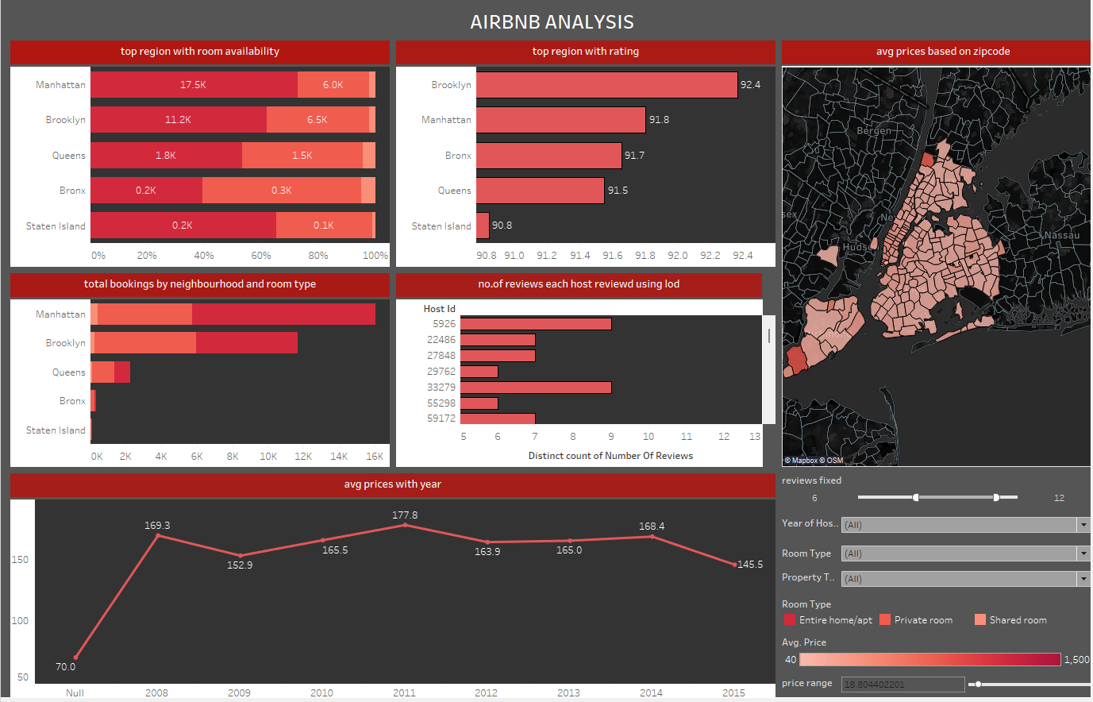
DATA DASHBOARD

Slide 6
Basic calculations:
AVG( review score rating)
Sum(beds)
Avg(price)
Count(name)
Discreate count( number of reviews)
LOD expression:
{ FIXED [Host Id]:COUNTD([Number Of Reviews])}
Table calculations
Sum(beds) with quick table calculations

Slide 7
Briefly describe the purpose and design of each graph:
Map graph shows the Airbnb in NewYork city with respective zip codes.
Second bar graph represents the most reviewed region with the neighborhood.
Third graph shows the availability of the rooms with respective to the neighborhood.
Next graph tells about the average price for a particular year.
Five graph explains the total books respective to room using a bar graph

Slide 8
Thank you

